Slide 1
Data Analytics Capstone Project
History of Data Breaches in U.S
Model Building & Evaluation
presented by
Miriam Rodriguez

Slide 2
Purpose
Determine the best data model to use to predict:
The type of breach that can occur in an organization (look at trends).
Which organizations are most vulnerable
Likelihood of a specific type of breach

Slide 3
Modeling Approach
Look at a variety of modeling algorithms:
Unsupervised machine learning
Supervised machine learning - Classification
Linear regression and Logistic regression
Evaluate, adjust and finalize the model that fits the data the best.
Goal is to fit the data into that model to answer business questions.

Slide 4
Supervised Text Classification Modeling – for Incident Descriptions
Used Breach Type as Classifier
Processed Descriptions from Privacy_Rights_Clearinghouse-Data-Breaches-Export.csv
Preprocessing and feature engineering (Words to Vectors)
Model Building, Validation, Evaluation using Split Validation, Grid Search, Cross Validation
Used a variety of classifiers

Slide 5
Classification Models Utilized for Text processing
Naive Bayes Multinomial
kNeighbors Classifier (kNN)
SVM (Support Vector Machine)
Random Forest
0.63691931540342295
0.68052159739201301
0.783211083945
0.94132029339853296
Models
Overall Accuracy

Slide 6
Classification Models Utilized for Text processing Adjustments to Improve Models
Naive Bayes Multinomial
Removed Stop Words
After Grid Search-no adjust
Cross-Validation 10 fold
After Grid Search – new parameters
kNeighbors Classifier (kNN)
Not able to improve
SVM (Support Vector Machine)
Not able to improve
Random Forest
0.66462917685411571
0.72290138549307248
0.717871168729 0.68581907090464544
0.68052159739201301
0.783211083945
0.94132029339853296
Models
Overall Accuracy

Slide 7
Classification Report: for Naïve Bayes
precision recall f1-score support
CARD 0.00 0.00 0.00 18
DISC 0.78 0.30 0.43 504
HACK 0.59 0.93 0.72 746
INSD 0.83 0.21 0.34 165
PHYS 0.61 0.80 0.69 523
PORT 0.77 0.75 0.76 351
STAT 0.00 0.00 0.00 73
UNKN 0.00 0.00 0.00 74
avg/total
0.63 0.64 0.59 2454

Slide 8
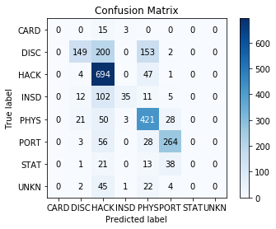
Naïve Bayes Confusion Matrix
Overall accuracy = 0.636919315403
Highest accuracy shows 'Hack' with 694 correct classifications
Next highest is 'Phys' with 421 correct classifications, then 'PORT' with 264.
200 were miscalculated as Hack when they should have been DISC. 153 were mis-categorized as 'PHYS' when should be 'DISC'.

Slide 9
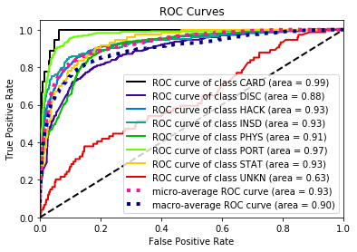
Naïve Bayes – ROC Curve
Explanation of the ROC Curves: The steeper the curve the more accurate it is.
The highest accuracy is shown by the CARD breach type, followed by PORT.
The lowest accuracy is shown by the UNKN breach type.
This is a better model than shown by the confusion matrix.

Slide 10
Fit Data to SVM model/Classification Report
precision recall f1-score support
CARD 0.67 0.44 0.53 18
DISC 0.71 0.70 0.71 504
HACK 0.83 0.87 0.85 746
INSD 0.84 0.77 0.80 165
PHYS 0.74 0.82 0.78 523
PORT 0.84 0.90 0.87 351
STAT 0.73 0.52 0.61 73
UNKN 0.67 0.05 0.10 74
avg / total 0.78 0.78 0.77 2454

Slide 11
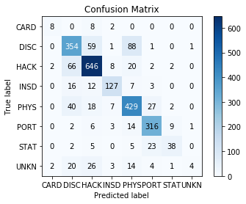
SVM Confusion Matrix
Overall accuracy = 0.783211083945
Highest accuracy shows 'Hack' with 646 correct classifications
Next highest is 'Phys' with 429 correct classifications, then 'DISC' with 354 and PORT with 316.

Slide 12
Fit Data to Random Forest model/Classification Report
precision recall f1-score support
CARD 1.00 1.00 1.00 18
DISC 0.88 0.88 0.88 504
HACK 0.97 0.94 0.96 746
INSD 1.00 0.99 1.00 165
PHYS 0.89 0.96 0.92 523
PORT 1.00 1.00 1.00 351
STAT 1.00 1.00 1.00 73
UNKN 1.00 0.77 0.87 74
avg/total
0.94 0.94 0.94 2454

Slide 13
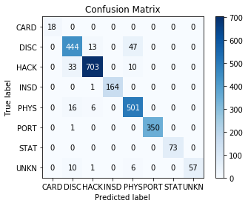
Random Forest Confusion Matrix
Overall accuracy 0.941320293399
CARD, STAT at 1.0 accuracy
PORT - 350 correctly predicted, 01 miscategorized as DISC
INSD - 164 correctly predicted, 01 miscategorized as HACK
PHYS - 501 correctly predicted, 06 miscategorized as HACK, 16 miscategorized as DISC
HACK - 703 correctly predicted, 33 miscategorized as DISC, 10 miscategorized as PHYS
DISC - 444 correctly predicted, 13 miscategorized as HACK, 47 miscategorized as PHYS
UNKN - 057 correctly predicted, 01 miscategorized as HACK, 10 miscategorized as DISC

Slide 14

Supervised Classification Modeling non-text features) – Breach Types
This is a multi-class classification
Data Prep –
Read cleaned data
Remove unimportant columns
Used Decision Tree Model Building, Validation, Evaluation
Observation - By adjusting the max depth to 6 and min samples to 45, improved accuracy of model
Used Split Validation 30/70

Slide 15
Decision Tree Model Results
precision recall f1-score support
Unknown 0.00 0.00 0.00 74
Credit Card 0.00 0.00 0.00 18
Hacking 0.57 0.66 0.61 746
Insider 0.34 0.15 0.20 165
Physical Loss 0.41 0.63 0.50 523
Portable Devc 0.35 0.38 0.37 351
Stationary 0.00 0.00 0.00 73
Disclosure 0.35 0.24 0.28 504
avg / total 0.41 0.45 0.42 2454

Slide 16
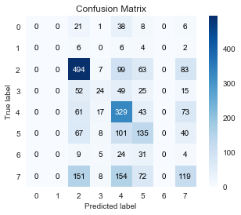
Decision Tree Model Results Confusion Matrix
Overall accuracy .448655256724
The decision tree model went from 40% to 45% accurate when adjusting the depth and number of leaves. Therefore, we expect that the model will be about 45% accurate when the model is applied into a real-world situation
Hacking is showing the most accurate prediction of all at 494.
Overall accuracy calculated as correctly classified 2454 total in test dsn = 45%

Slide 17
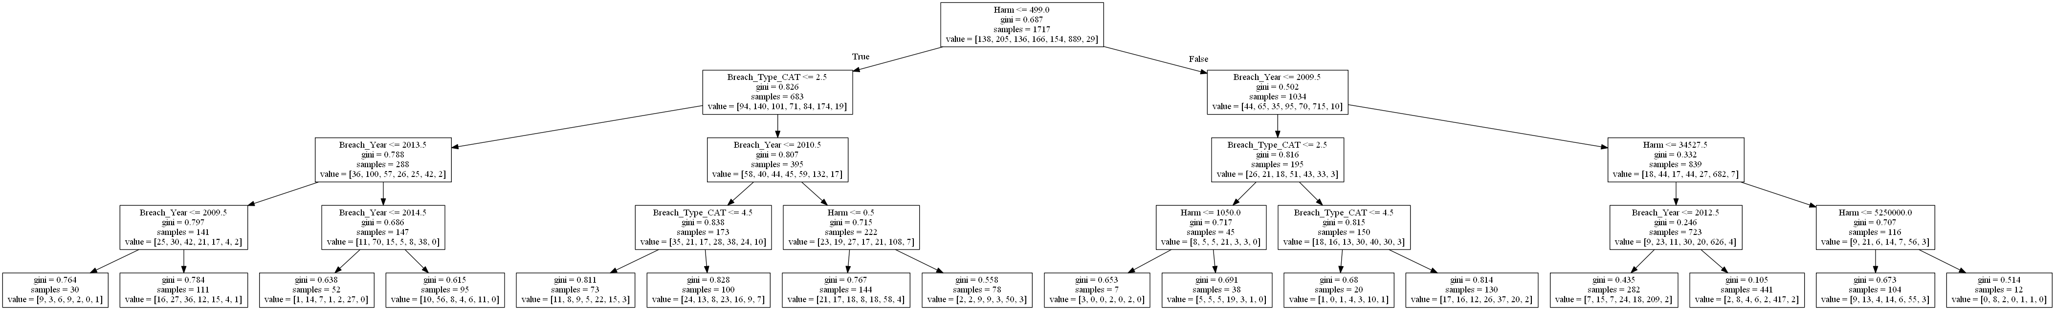
Decision Tree

Slide 18
Decision Tree Results
Decision Tree Model not a good fit but…
Created Scoring dataset by removing Breach Type from dataset (Y)
Fit scoring data to Decision Tree model and created ‘Predicted Y’
Overall accuracy = 0.950692746536

Slide 19
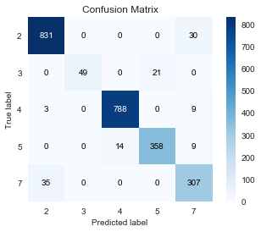
Decision Tree Confusion Matrix
Showing these features as the best predictors:
2: HACK - Hacking
3: INSD - Insider:
4: PHYS - Physical Loss:
5: PORT - Portable Device
7: DISC - Unintended Disclosure:
Reduced sample size from 45 to 5. With these features showing 95% accurate,
Physical loss being the most accurate and hacking the least.

Slide 20
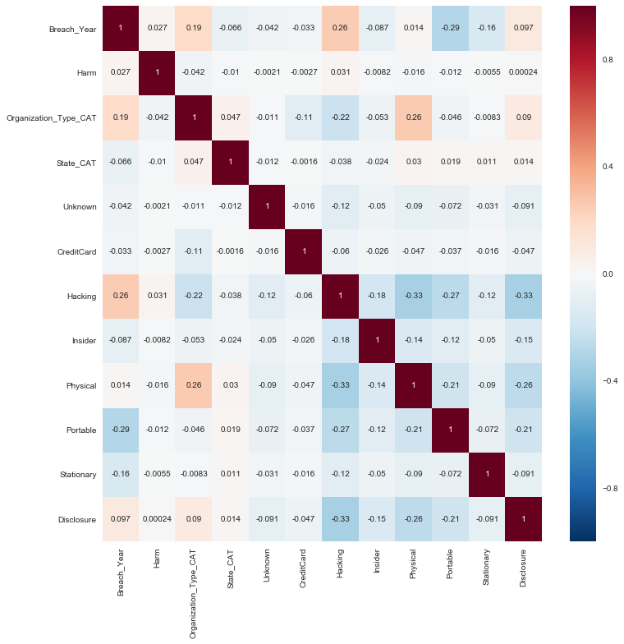
Correlation with Other features

Slide 21
Correlation with Other Features
What are the findings from correlation analysis?
The higher values seem to occur with hacking breaches.
Hacking and all other breach types show a negative correlation.
Physical breaches are also among the higher scores.
For the most part the correlation scores appear to be low.

Slide 22
Logistic and Logit Regression Results
Split Validation into Training and Test datasets
Overall accuracy 0.303993480033
Not a good model to use
Logit does not work for multi-class features.

Slide 23
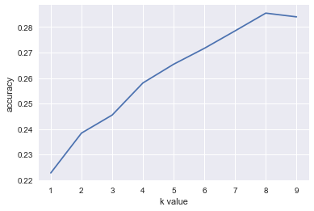
K-nearest Neighbors (knn) Using Grid Search
Optimal K-Value = 8,
overall accuracy 0.334148329258

Slide 24
Cross Evaluation- knn
[ 0.29539952 0.18401937 0.26876513 0.27118644 0.24697337 0.28329298 0.29297821 0.2590799 0.27007299 0.24264706 0.31127451 0.26108374 0.2962963 0.27160494 0.2691358 0.27407407 0.29382716 0.26419753 0.34814815 0.31111111]
Overall accuracy 0.275758414108
Not the best model to use
SelectKBest, Extra Tree Classifier, RFE also not good to use.

Slide 25
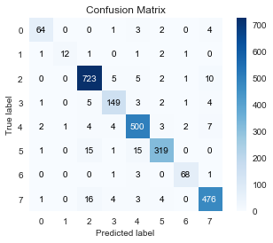
Random Forest
Overall accuracy = 0.94132029339853296
Best model to use for classification
Hacking showing largest population

Slide 26
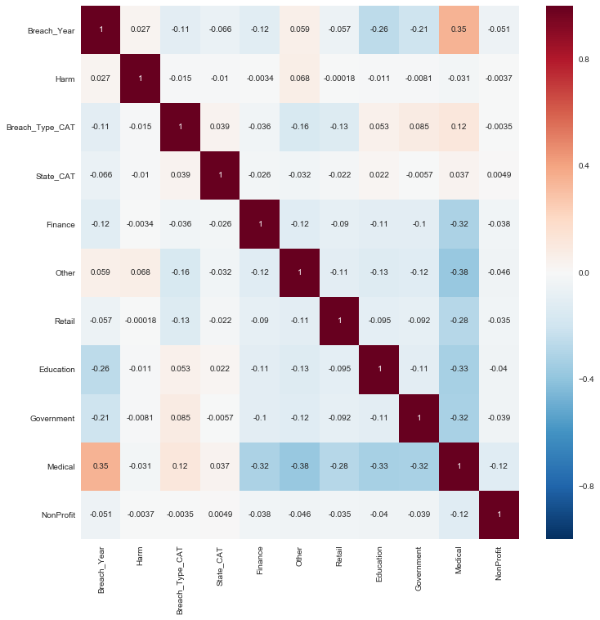
Organization Type Correlation

Slide 27
Organization Type Correlation Findings
The higher values seem to occur with medical and harm.
Retail and medical have a negative correlation.
Medical has a positive correlation with the other organizations.
For the most part the correlation scores appear to be low.

Slide 28
Supervised Text Classification Modeling Non-Text features - Organizations
Summary
Medical Organizations predicted the most
Tested same models as Breach Types
Random Forest best model to use at overall accuracy of .90.

Slide 29
Unclassified Machine Learning
Pre-Processing
Word Cloud
Topic Modeling
LDA Modeling
LSI Modeling

Slide 30
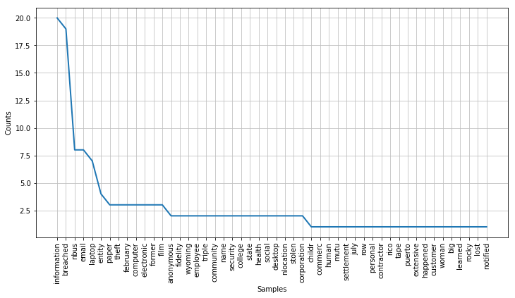
Unsupervised – Text Data Preprocessing and Results
Conducted word frequency analysis

Slide 31
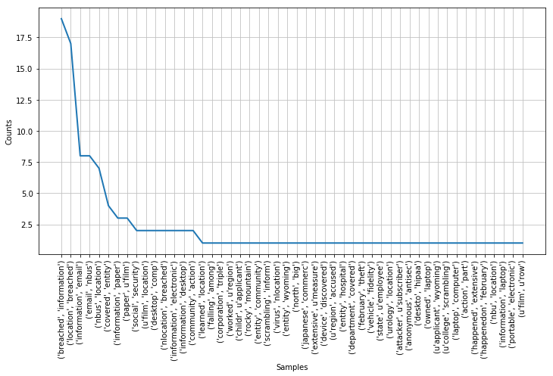
Unsupervised -Data Preprocessing and Results
Results Bigram Word Frequency Analysis

Slide 32
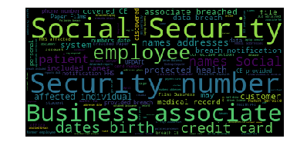
Unsupervised – Word Cloud Analysis
The themes here appear to be social security number, credit cards, birthdates, names and addresses, employees and business associates.

Slide 33
Methods – LDA Topic Modeling
Assigned the topics to the documents in corpus (Document-Topic Distribution)
Top 10 topics show persistent cases of physical loss, theft and hacking.
Used 10 for the number of topics.
Used pyLDAvis to generate a Intertopic Distance Map.

Slide 34
Top Topics from LDA Model
1) Hacking getting email, passwords, etc.
2) Credit card and bank accounts, lawsuit
3) Unauthorized access to payment systems
4) University, student, computer files, documents
9) Stolen laptop from employee containing patient medical information, birthdate, etc.

Slide 35
Top Topics from LSI Model “Latent Semantic Indexing ”
Similar to LDA only in different order and less clear
1) Breaches relating to business and servers.
2) Stolen laptop from employee containing patient medical information.
3) Breaches related to email
LSI shows topics that appear similar, but harder to differentiate topics in this case.
Prefer LDA topic model.

Slide 36
Conclusion
For unsupervised topic modeling, prefer LDA
For all supervised classification models for description data, will use Random Forest.

